Slide 1
Data Publishing Bootcamp
Daniella Lowenberg (California Digital Library)

Slide 2
Today’s Goal: Get your data published

Slide 3
What are data?

Slide 4
Data are…
Values, numerics behind averages and standard deviations
Values extracted from images, blots, gels
Qualitative information, answers to interviews and surveys
...the necessary information to evaluate, re-use, or reproduce your research!

Slide 5
Terminology
Open Data
Part of the Open Access (OA) movement. Data that can be freely used, re-used, re-distributed (under CC-BY license)
Data Publication
Sharing your data publicly (open data) in a repository or platform that grants DOIs or stable identifiers for the purpose of re-use
Data Repository
Place where data can be preserved, accessible, and citable

Slide 6
Terminology
Metadata
Data that describe your data!
DOI
Persistent identifier used for location of and citation of scholarly output
Data Citation
Citing data by their DOIs or stable identifier in the same manner as an article publication

Slide 7
Why should I share my data?

Slide 8
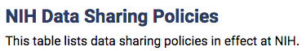
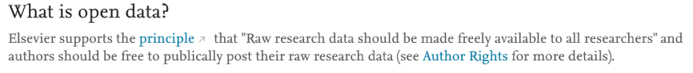

Slide 9

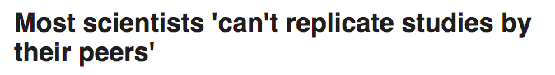
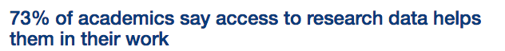
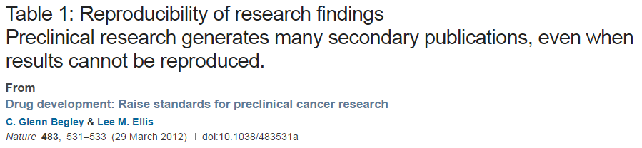

Slide 10
How should I prepare my data?

Slide 11
Mindset: Make it Usable

Slide 12
How to make your data usable
Publish and archive your data
Use open and field standard formats/terminologies
Document all info needed to understand data

Slide 13
Is there a standard in your field?
MIAME
http://www.fged.org/projects/miame/ CONSORT standard for clinical trials
https://fairsharing.org/bsg-s000141
Find a standard: https://fairsharing.org/

Slide 14
Activity: what is needed to reproduce your research?

Slide 15


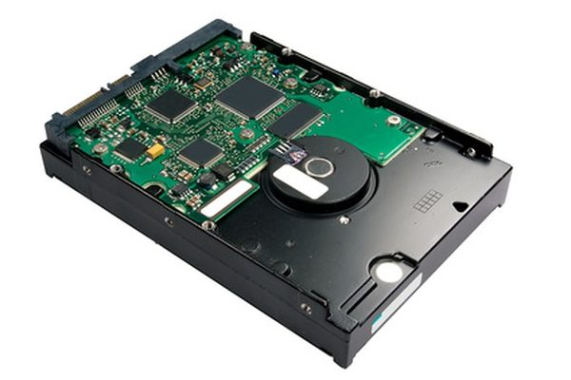
Working Storage ≠ Preservation

Slide 16
Where should I publish my data?

Slide 17
Research data repositories
Comply with field standards
www.re3data.org
Utilize repository guides
http://journals.plos.org/plosone/s/data-availability#loc-recommended-repositories

Slide 19
How do I get credit for my data?

Slide 20
Cite your data!!

Slide 21
Publishing data increases citations
Piwowar HA, Vision TJ. (2013) Data reuse and the open data citation advantage. PeerJ 1:e175https://doi.org/10.7717/peerj.175

Slide 22
What about sensitive data?

Slide 23
It is your responsibility to ensure your data are anonymized and de-identified, and have consent to be shared

Slide 24
Misconceptions & solutions
De-identification should be within the realm of your IRB approvals
Identifying data are often sent to publishers in violation of consent forms/IRBs
If data cannot be shared publicly, data need to be available upon request (this is compliant)
Subject area does not imply sensitive:
Ex. Abortion (public) v Abortion (private)
Institutions & repositories working on solutions for sharing and storing sensitive data

Slide 25
Questions?
Contact UCLA Libraries at http://www.library.ucla.edu/node/945
Daniella Lowenberg
Daniella.lowenberg@ucop.edu

